Slide 1

COMMODITY FUTURES
Module 3

Slide 2
Origins and History
Ancient Origins:
The history and origin of commodity futures can be traced back to ancient civilizations, but the modern concept of organized commodity futures markets emerged in the 19th century.
The roots of futures trading can be traced back to ancient civilizations where farmers, traders, and merchants engaged in informal agreements to secure prices for future delivery of agricultural goods. These early contracts were often based on trust and personal relationships.
19th Century:
The modern era of commodity futures began to evolve in the 19th century. Chicago emerged as a key hub for agricultural trading. The Chicago Board of Trade (CBOT) was established in 1848, primarily to standardize grain trading and provide a centralized marketplace.
The creation of futures contracts standardized the terms of the agreements, making them more tradable and reducing counterparty risk. This innovation facilitated greater participation and liquidity in the markets.
16th-18th Century:
During the 16th to 18th centuries, formalized commodity trading began to take shape in Japan with the Dojima Rice Exchange, where samurai used rice futures contracts to hedge against the risk of price fluctuations.
20th Century:
The commodity futures markets continued to expand in the 20th century, with the establishment of additional exchanges and the introduction of futures contracts on a broader range of commodities, including metals, energy, and financial instruments.
Regulatory frameworks were developed to ensure the integrity of these markets. In the United States, the Commodity Exchange Act (CEA) of 1936 laid the foundation for the regulation of commodity futures trading, creating the Commodity Futures Trading Commission (CFTC) in 1974.

Slide 3

Types of Commodities Traded
1. Hard Commodities:
Metals: Gold, silver, copper.
Energy: Crude oil, natural gas.
Livestock: Cattle, hogs/pork bellies.
Agricultural: Corn, soybeans, wheat, cocoa, coffee.
2. Soft Commodities:
Livestock: Lean hogs.
Agricultural: Cotton, orange juice, sugar, lumber, rough rice.
Softs: Cocoa, coffee.
3.Additional Categories:
Financial Commodities: Currencies (Forex), interest rates (Treasury bonds, Eurodollar futures).
Weather Derivatives: Temperature-related contracts (Heating Degree Days, Cooling Degree Days).

Slide 4
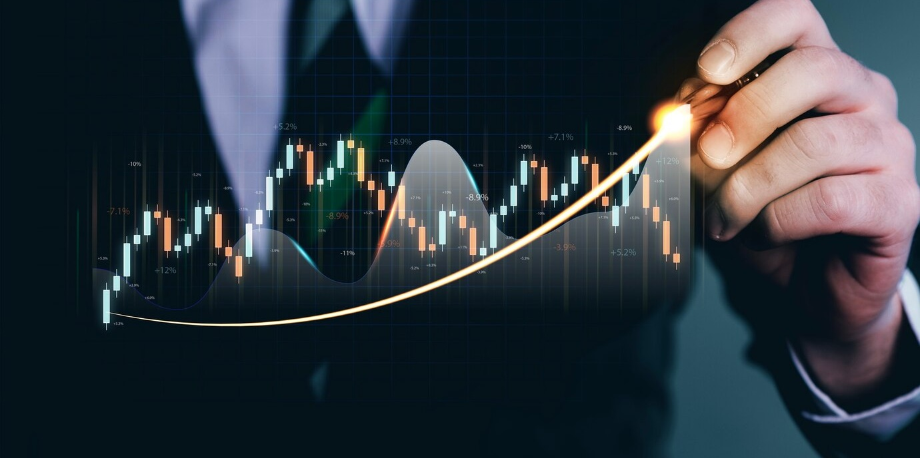
Structures of Commodities Market in India
MCX, NCDEX, and ICEX are prominent commodity exchanges in India. MCX covers metals, energy, and agriculture, while NCDEX specializes in grains and spices. ICEX focuses on energy and metal derivatives, collectively forming a diverse commodities trading landscape in the country.
Futures and options contracts are fundamental in India's commodities market, facilitating standardized agreements for buying and selling various commodities like agricultural products, metals, energy sources, and other items.
02
03
The market's infrastructure involves clearing corporations, electronic trading platforms, and storage facilities, while educational initiatives enhance awareness. India's commodities market is globally integrated, allowing international participation and exposure.
The commodities market in India is organized through exchanges and regulated by the Securities and Exchange Board of India (SEBI) and the Forward Markets Commission (FMC)
01
04

Slide 5
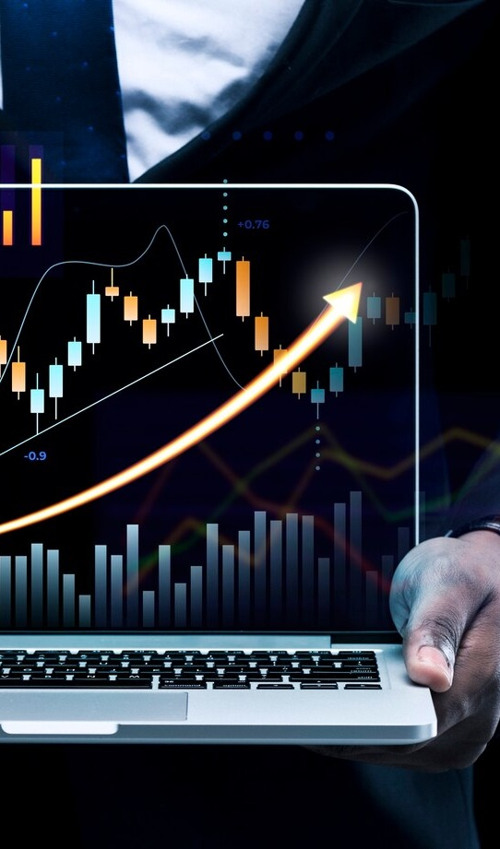
Participants in Commodity Markets
Hedgers: Manage price risks in physical markets.
Speculators: Profit from commodity price movements.
Arbitrageurs: Exploit price differences for profit.
Commodity Trading Advisors (CTAs): Offer professional trading advice.
Retail Investors: Diversify portfolios through commodity investments.
Market Makers: Facilitate liquidity with bid and ask quotes.
Clearing Members: Ensure smooth trade settlement.
Exchanges: Provide regulated platforms for trading.
Regulators: Oversee and regulate commodities markets, ensuring fairness and integrity.

Slide 6
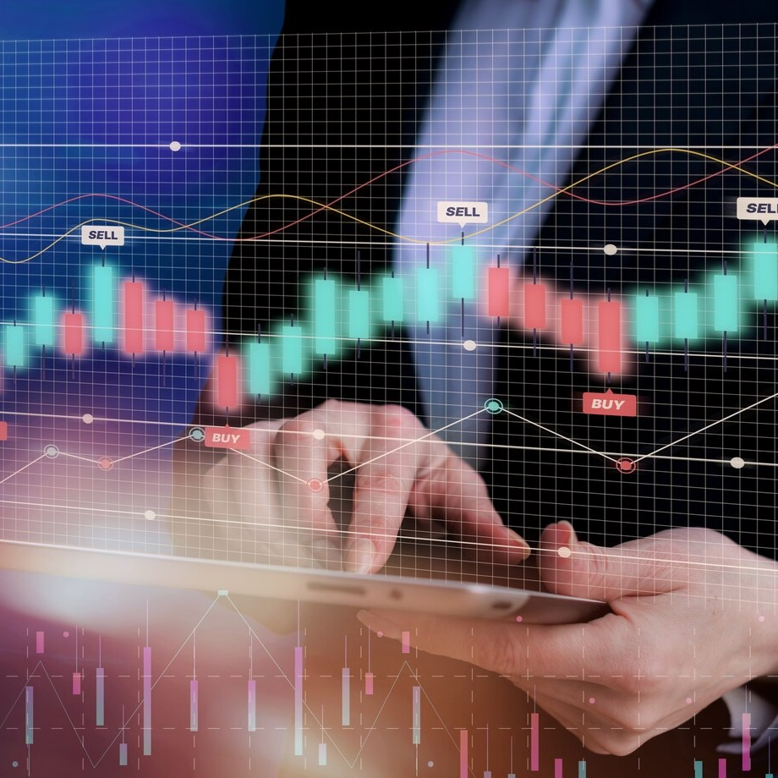
Trading in Commodities in India (Cash and Derivative Segment)
Cash Segment:
Spot Market: Immediate physical buying and selling, settled on the spot.
Physical Exchanges: Transactions in localized settings, e.g., Agricultural Produce Market Committees.
Derivative Segment:
Commodity Futures: Standardized contracts for future delivery on exchanges like MCX and NCDEX.
Options Contracts: Provide the right to buy/sell at a predetermined price, enhancing hedging.
Hedging: Reduces business impact from price volatility.
Speculation: Traders engage for profit and contribute to efficient price discovery.
Regulatory Framework: SEBI ensures compliance for market integrity and investor protection.
Electronic Trading Platforms: Quick and transparent order matching.
Clearing and Settlement: Managed by clearing corporations, with margin requirements.
Global Integration: Increasingly linked with global markets, offering international exposure.

Slide 7
Commodity Exchange in India and Abroad
Commodity Exchanges in India:
Multi Commodity Exchange (MCX):
Overview: One of India's largest commodity exchanges.
Commodities Traded: Metals, energy, agricultural products.
National Commodity and Derivatives Exchange (NCDEX):
Overview: Specializes in agricultural commodities.
Commodities Traded: Grains, pulses, spices, oils.
Indian Commodity Exchange (ICEX):
Overview: Focuses on commodity derivatives, especially in energy and metals.
Commodities Traded: Energy products, metals.
Commodity Exchanges Abroad:
Chicago Mercantile Exchange (CME Group):
Overview: One of the largest global derivatives exchanges.
Commodities Traded: Agricultural products, energy, metals.
Intercontinental Exchange (ICE):
Overview: Operates global exchanges and clearinghouses.
Commodities Traded: Energy, agriculture, metals.
London Metal Exchange (LME):
Overview: Specializes in non-ferrous metals trading.
Commodities Traded: Copper, aluminum, nickel.
Tokyo Commodity Exchange (TOCOM):
Overview: Japan's leading commodity futures exchange.
Commodities Traded: Precious metals, energy, rubber

Slide 8

Reasons for Investing in Commodities
Diversification: Low correlation with stocks and bonds.
Inflation Hedge: Preserves purchasing power.
Risk Management: Futures for stability in cash flows.
Supply and Demand Dynamics: Influenced by global factors.
Global Economic Growth: Linked to economic expansions.
Portfolio Inflation Protection: Acts as a store of value.
Tangible Assets: Intrinsic value in physical goods.
Speculative Opportunities: Short-term trading potential.
Emerging Market Growth: Benefits from emerging economies.
Alternative Investments: Offers a unique risk-return profile.

Slide 9




Commodity Derivatives
Financial instruments whose value is derived from an underlying commodity.
Used for hedging against price fluctuations and for speculative trading.
Includes futures contracts and options contracts.
Can be based on various commodities such as metals, energy, agriculture, or financial instruments.
Provides the ability to control a larger position with a relatively smaller amount of capital.
Involves hedgers (producers, consumers), speculators, and arbitrageurs.
Can be settled through physical delivery of the commodity or cash settlement based on market prices.
Influenced by supply and demand dynamics, geopolitical factors, and global economic conditions.
Helps manage and mitigate price risks associated with commodity price volatility.
Traded on commodity exchanges like MCX, NCDEX, CME, and ICE.
Regulated by financial authorities such as SEBI (in India) to ensure market integrity.
Standardized terms including contract size, expiration date, and price quotation.

Slide 10
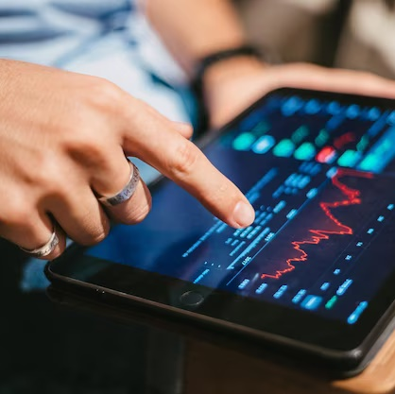


Commodity Exchanges
Definition
Key Exchanges
Role
Organized platforms that facilitate the buying and selling of commodity derivatives and contracts.
MCX (Multi Commodity Exchange), NCDEX (National Commodity and Derivatives Exchange), ICEX (Indian Commodity Exchange).
Provides a regulated marketplace for participants to trade in commodity derivatives.

Slide 11

Other Features
Listed commodities include but not limited to metals (gold, silver), energy (crude oil, natural gas), and agricultural products (wheat, soybeans).
High liquidity due to active participation of various market participants.
Utilize electronic trading platforms for quick and transparent order matching.
Regulated by financial authorities to ensure fair practices and market integrity (e.g., SEBI in India).
Clearing corporations manage the settlement process, and margin requirements are in place to cover potential losses.
Increasingly integrated with global markets, allowing international participation and exposure.

Slide 12
Commodity Contracts
Agreements specifying the terms for buying or selling commodities. Includes futures and options contracts.
Futures Contracts: Obligation to buy/sell a commodity at a future date at a predetermined price.
Options Contracts: Provide the right (but not the obligation) to buy/sell a commodity within a specified period at a predetermined price.
Used for risk management, hedging against price volatility, and speculative trading.
Contracts have standardized terms, including contract size, expiration date, and price quotation.
Can be based on various commodities like metals, energy, agricultural products, or financial instruments.
Provides leverage, allowing traders to control a larger position with a relatively smaller amount of capital.
Traded on commodity exchanges such as MCX, NCDEX, CME, ICE.
Settlement Method:
Physical Delivery: Actual delivery of the commodity.
Cash Settlement: Settlement in cash based on market prices.
Participants Involves hedgers (producers, consumers), speculators, and arbitrageurs.
Regulated by financial authorities to ensure fair practices and market integrity.
Involves potential for profit or loss based on commodity price movements.
Futures contracts have a specified expiration date when the contract ends. Options contracts may be exercised before or at expiration.

Slide 13
Pricing of Commodity Contracts
Spot Price: The current market price of the commodity. It serves as the foundation for forward contract pricing.
Risk-Free Rate: The interest rate that could be earned on a risk-free investment. It accounts for the time value of money and reflects the opportunity cost of tying up capital.
Time to Maturity: The period until the forward contract's expiration. The longer the time to maturity, the higher the potential impact on the forward price.
Cost of Carry: Expenses associated with holding the physical commodity until the contract's maturity. This includes storage costs, insurance, and any income or benefits generated by holding the commodity.

Slide 14
Pricing Related Concepts You gots to know bruv
Contango & Backwardation
Limitation
Formula
Contango: When forward prices are higher than the spot price, indicating an anticipated price increase.
Backwardation: When forward prices are lower than the spot price, suggesting an expected price decrease.
Forward pricing models assume constant risk-free rates and storage costs, which may not hold true in dynamic and changing market conditions.
The forward price is often calculated using the formula: Forward Price = Spot Price * e^(r * T), where 'e' is the mathematical constant (approximately 2.71828), 'r' is the risk-free rate, and 'T' is the time to maturity.

Slide 15
Pricing in Commodity Futures
Spot Price
The current market price of the commodity.
Expected Future Spot Price
Anticipated future market price based on market expectations
Risk-Free Rate
The interest rate, considering the time value of money.
Arbitrage Opportunities
Traders exploit price differences between spot and futures markets

Slide 16


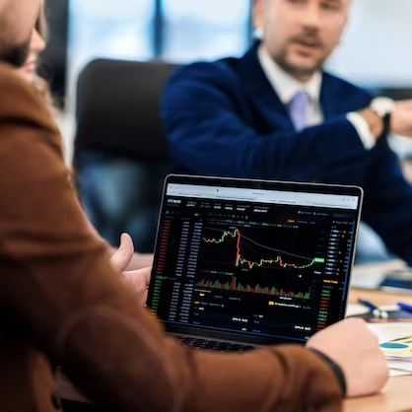

Perfect & Imperfect Hedge
Perfect Hedge: The hedge completely eliminates the risk, and the gain or loss in the cash market is offset by an equal loss or gain in the futures market.
Imperfect Hedge: Some risk remains, and the gains or losses in the cash and futures markets may not perfectly offset each other

Slide 17
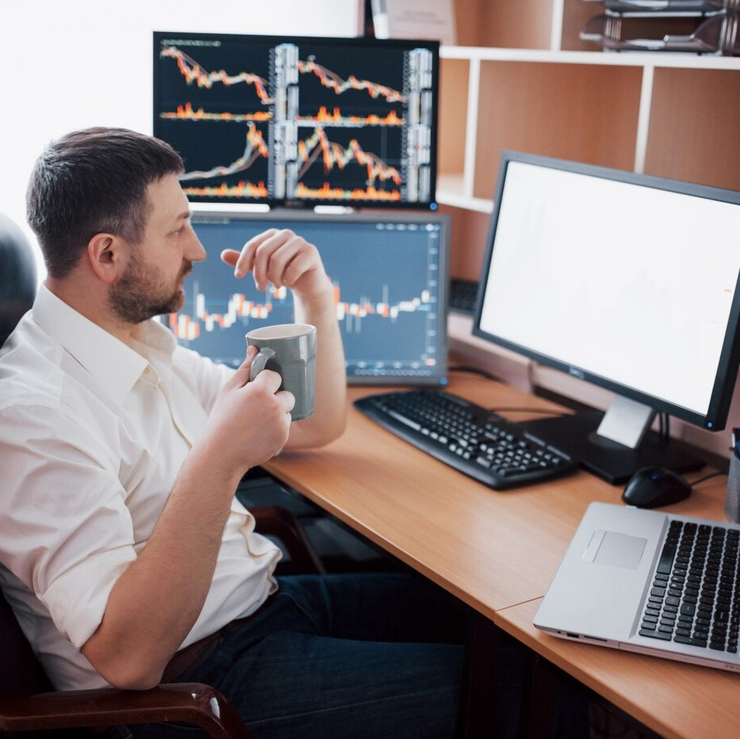


Basis Risks in Commodity Future
The risk that the basis (difference between the spot and futures prices) may change during the hedging period is known as Basis Risk, Factors such as changes in supply and demand, transportation costs, or market expectations, Continuous monitoring, adjusting hedges, and using financial instruments to manage basis risk.

Slide 18

Optimal Hedge Ratio
Price Volatility: Higher volatility may lead to a higher optimal hedge ratio to mitigate risk.
The ratio of the size of a futures position to the size of the exposure in the spot market, aiming to minimize risk.
Determined through statistical analysis, often using regression analysis to quantify the historical relationship between changes in futures prices and changes in spot prices.
The optimal hedge ratio is the slope coefficient of the regression equation.
Correlation: The historical relationship between spot and futures prices.
Time Horizon: The period for which the hedge is intended.

Slide 19
Thanks for Watching!
©2022 MSLIDES Copyright

